Slide 1
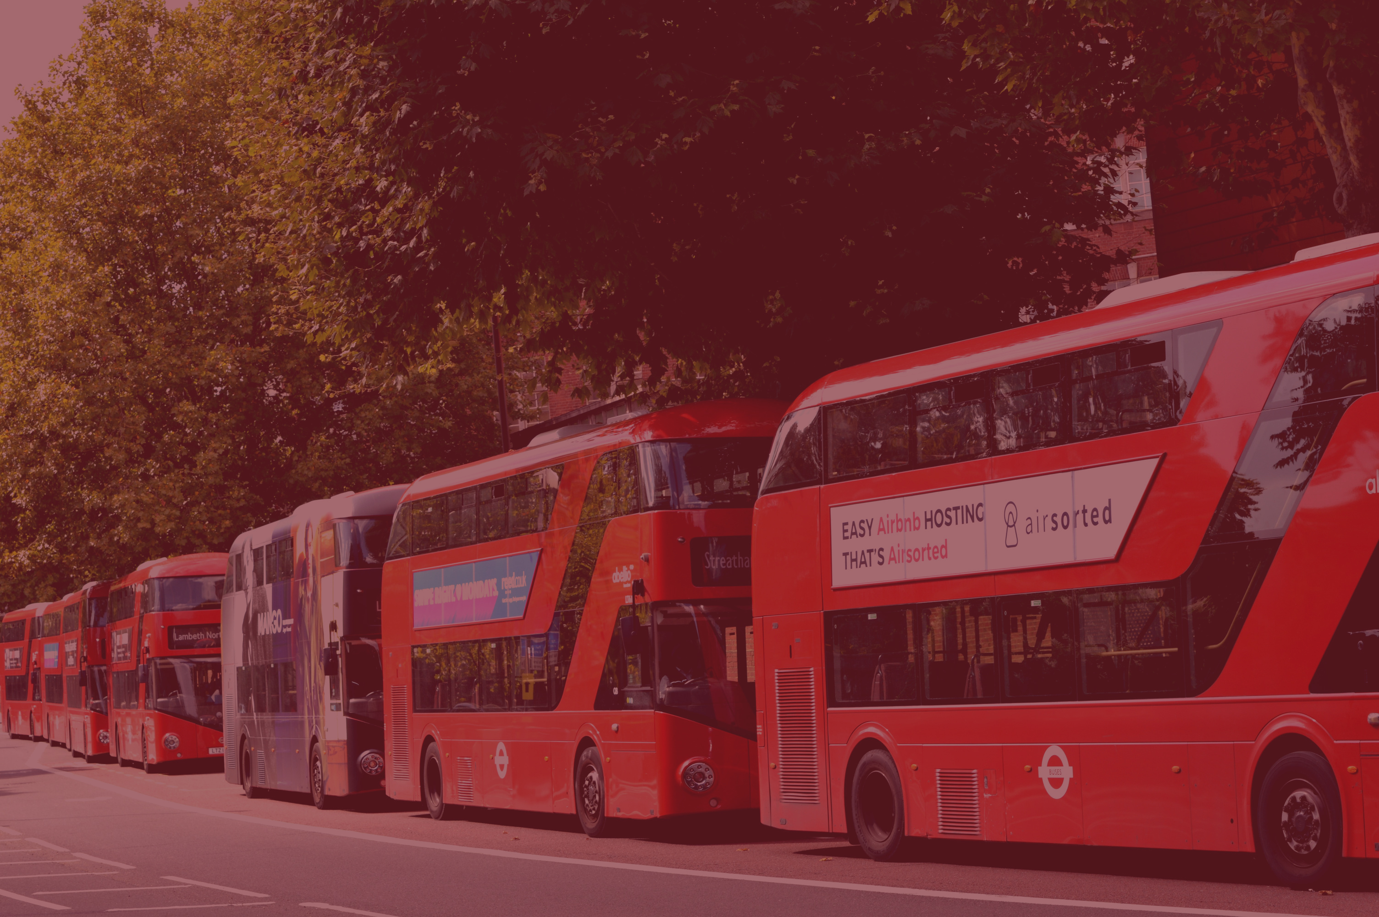

Exploring California Commute Trends
A Lens for Bahrain Transport Future
Prepared by: Mariam Azam
Data Analytics Immersive Bootcamp Fellow, General Assembly
June - July | 2025

Slide 2







AGENDA
Purpose
Goals
Datasets
Key Findings
Insights
Suggestions

Slide 3
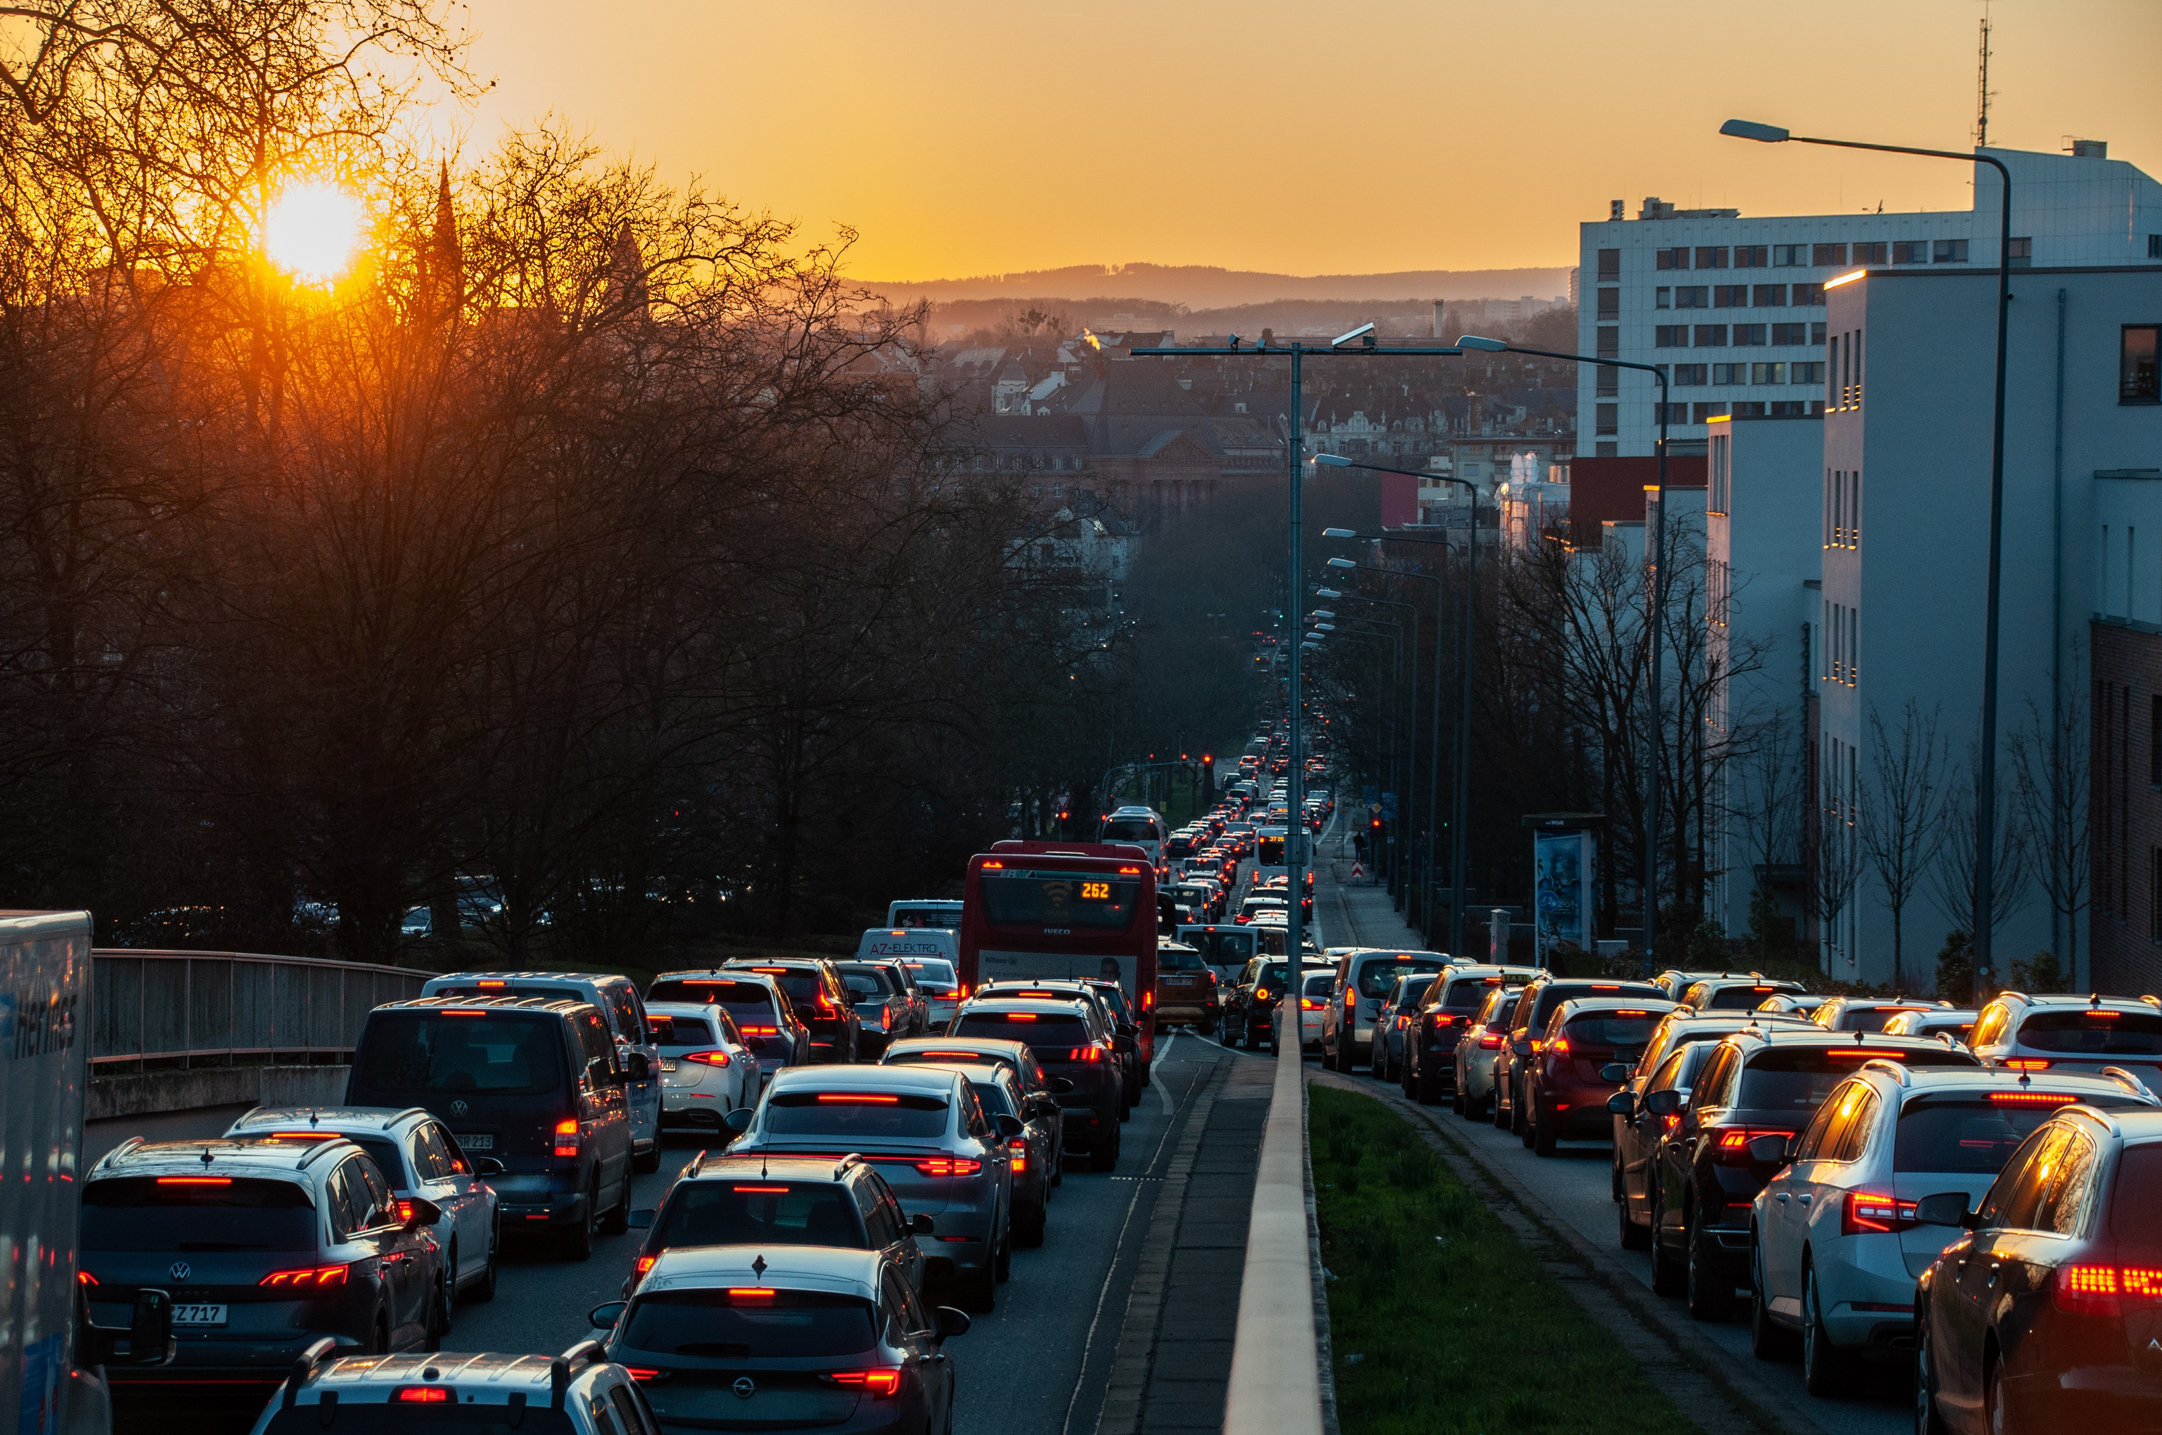
Introduction
The Commute Challenge
Commuting to work is a key part of daily life and shapes access to jobs, services, and opportunities. How people commute reflects patterns of access, affordability, and equity.
Challenges in commuting contribute to mobility gaps, road congestion, safety risks, longer commute times, and growing inequities across regions, income levels, and racial groups.

Slide 4



Bahrain 2030 Vision:
Transport Highlights
California Commute Patterns:
Case Study
A world-class infrastructure links Bahrain to the global economy
Varying commuting choices across regions and ethnic groups, raising important questions about the inclusiveness and efficiency of the transportation system.
As part of its long-term vision, the Kingdom aims include:
Accessible & Affordable Public Transport
Longstanding challenges with traffic congestion and mobility, making it a valuable case study for understanding the relationship of various aspects with regards to public transit system.
Strategic Planning for Transport Networks
Private Sector as a Partner in Progress

Slide 5






Objectives
Target Audience
Geographic and Demographic Trends in Commute Choices
Government Authorities
Influence of Socioeconomic Factors i.e., income on Commute Choices
Public Transport Companies
Overtime Shifts in Commute Patterns
Insights Applicable to Bahrain Transportation Goals
Research & Academic Institutions

Slide 6






Dataset Overview
Data Sources: U.S. Census Bureau, Decennial Census & American Community Survey
Data Size: 336K Rows
Report Year
Geography
Ethnicity
Commute Mode
Population
Income
Displays: (2000 | 2005-2010)
Commute Modes used by California residents aged 16 years & older
Displays:
Income $

Slide 7
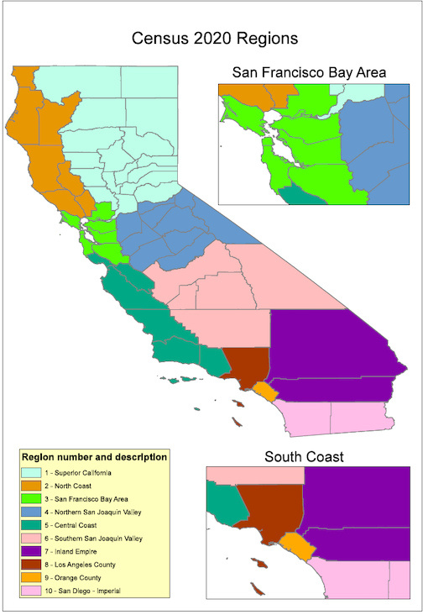
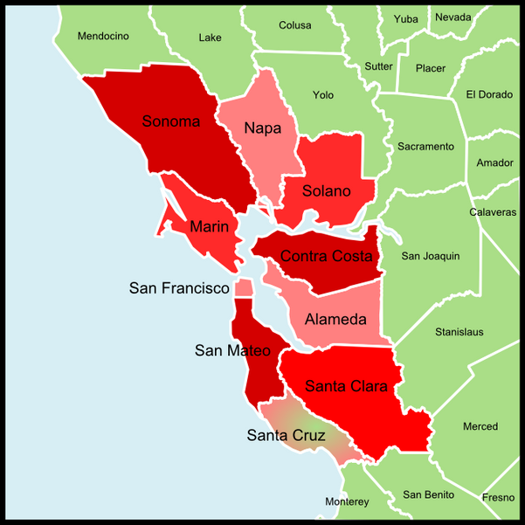
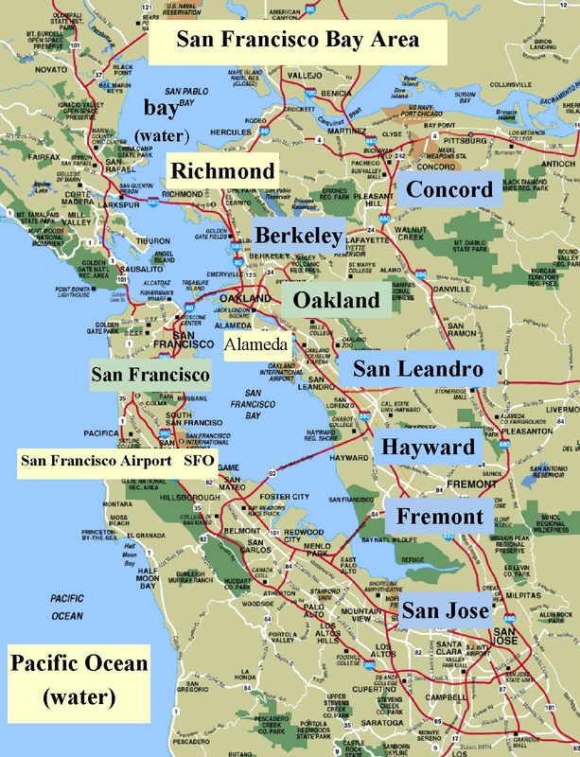
Geography
REGIONS
COUNTIES
PLACES

Slide 8
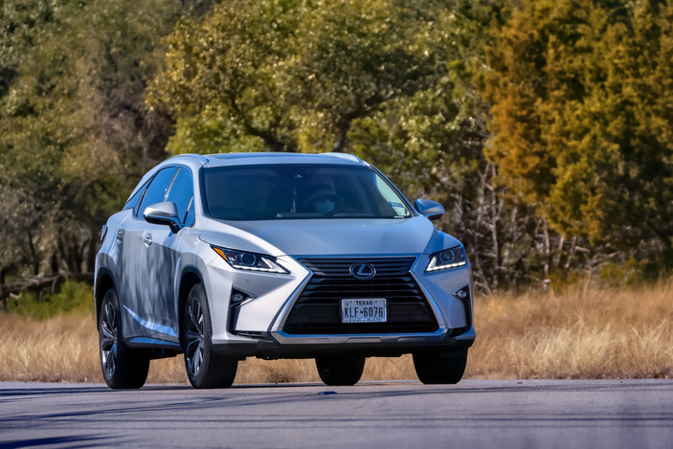

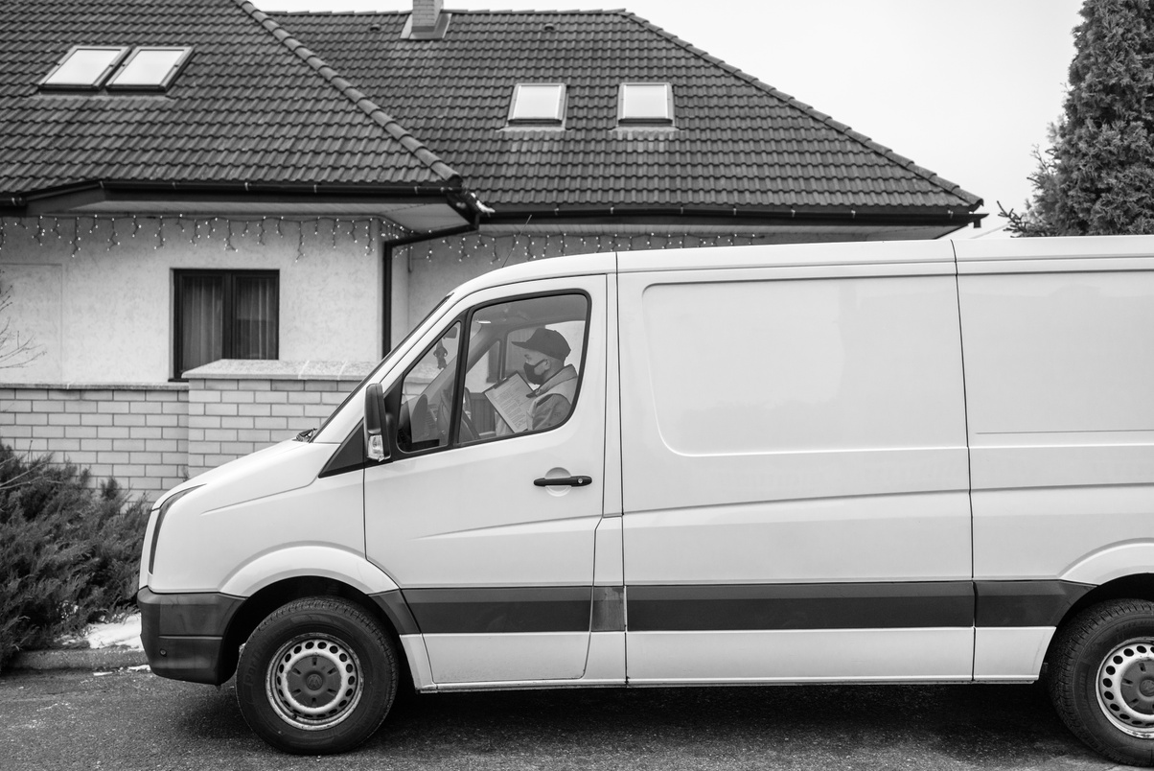
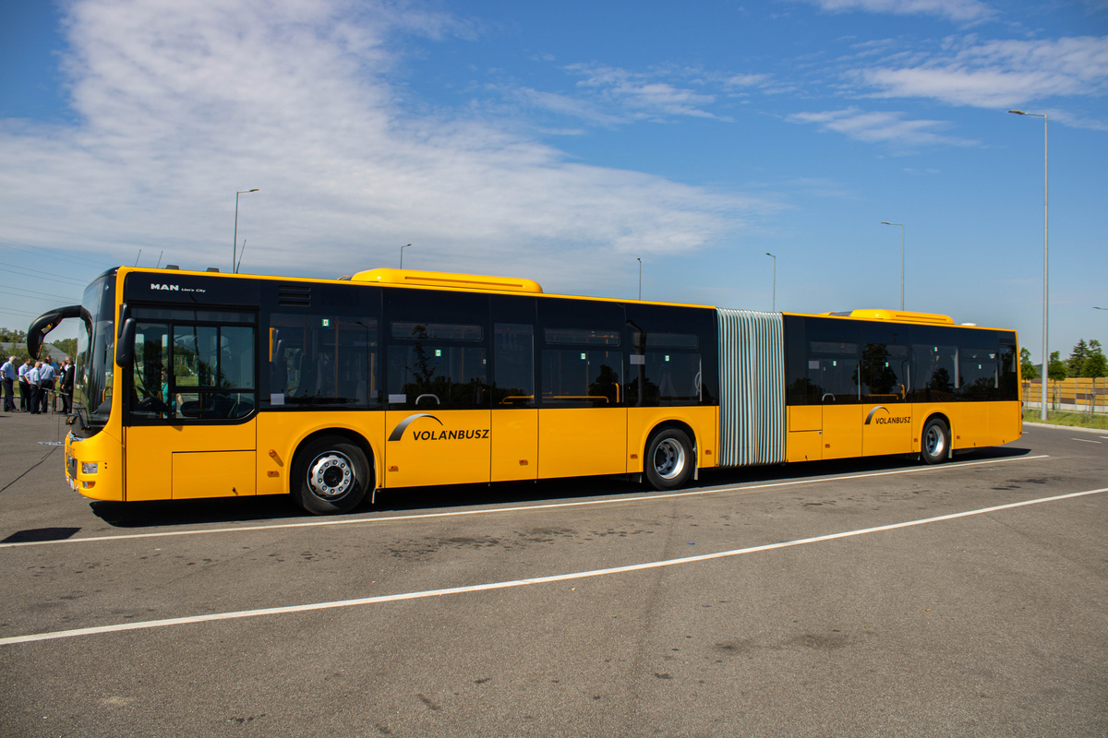



Commute Modes
Car, Truck, Van: Drive Alone / Carpool
3
Public Transport
Bicycle
Walked to Work
Worked at Home

Slide 9


GEOGRAPHICAL TRENDS
What are the most common commuting mode used in California?
How do they vary by region?
How does public transport usage correlate with population size?

Slide 10

Statewide Statistics
Total
Population
16M
7M
5M
2M
851K
274K
WHITE
LATINO
ASIAN
AFRICAN
AMERICAN
MULTIPLE
851K
Car Dependency

Slide 11
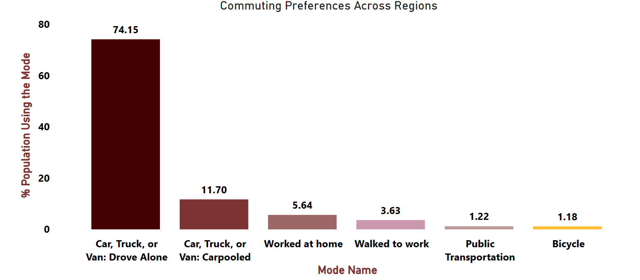
Driving Alone Dominates Across All Regions

Slide 12
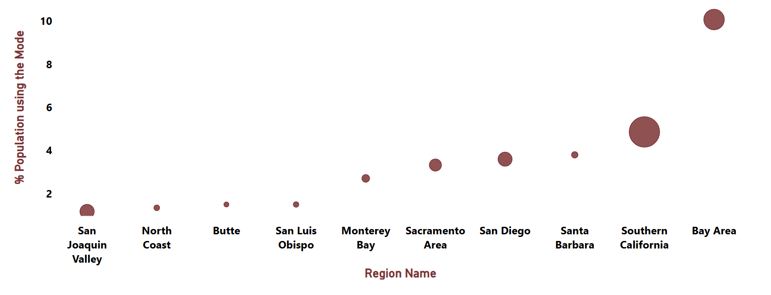
High Population Doesn’t Always Mean High Transit Use
Bubble Size = Population Size

Slide 13
DEMOGRAPHIC TRENDS
Which ethnic groups are most and least likely to use public transportation?

Slide 14
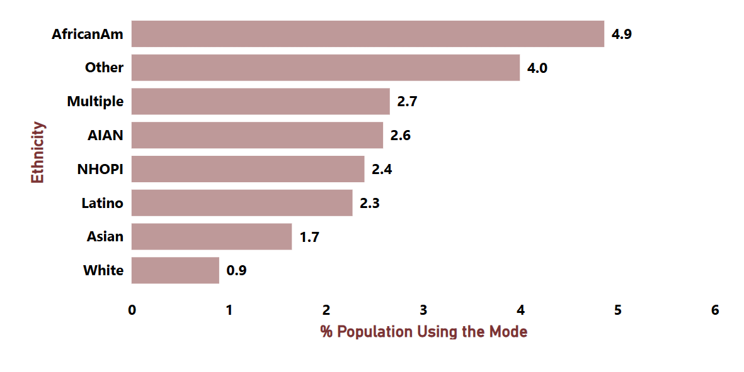
African Americans Use Public Transit the Most
AIAN: American Indians and Alaska Natives
NHOPI: Native Hawaiian or Other Pacific Islander

Slide 15
SOCIOECONOMIC FACTOR:
INCOME
How do income levels influence commute choices?

Slide 16
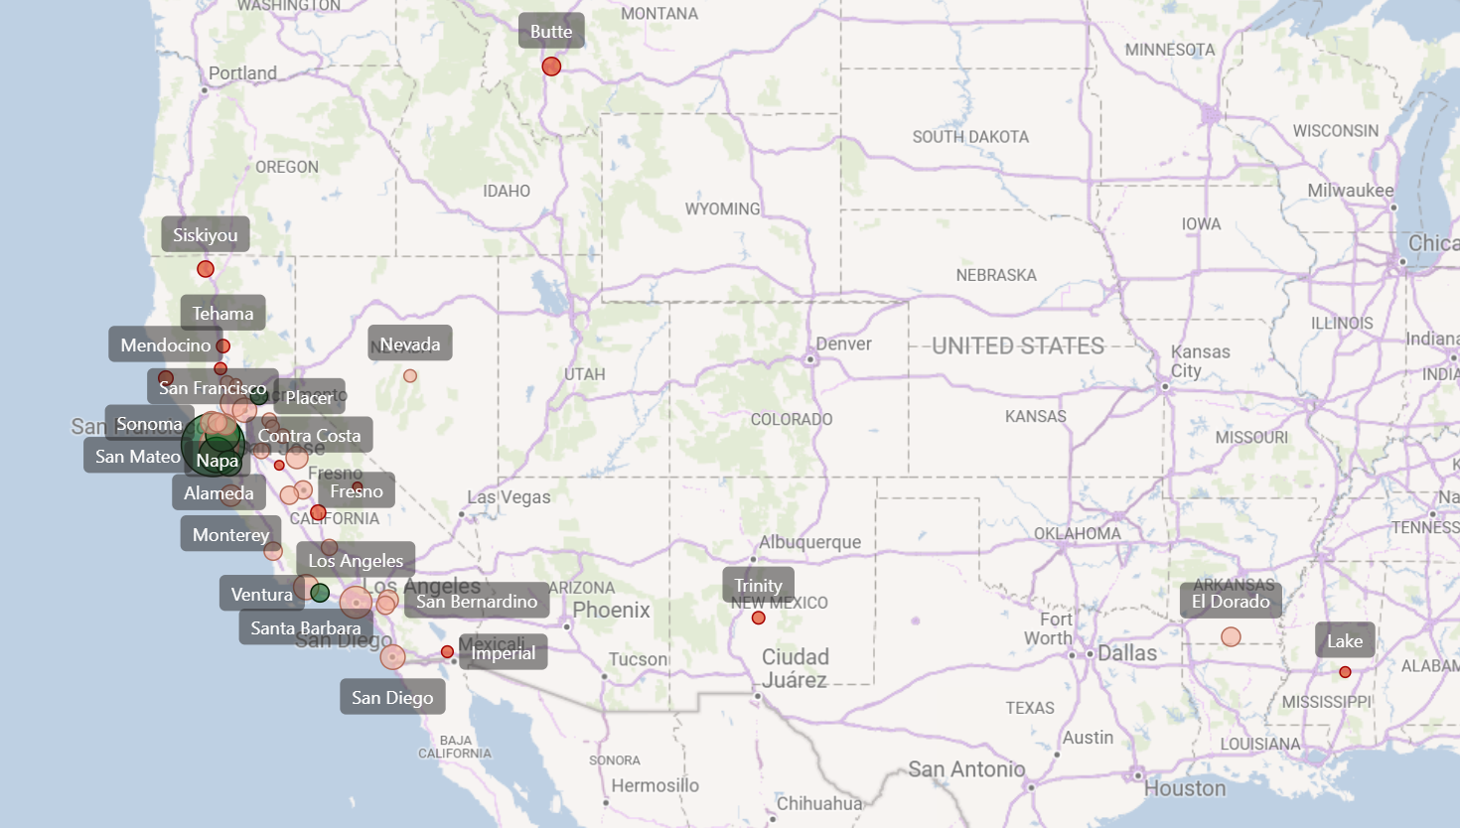
Mapping Transit Use by Geography and Income

Slide 17
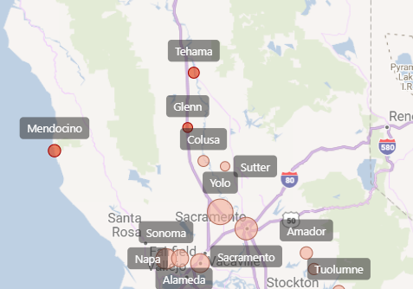
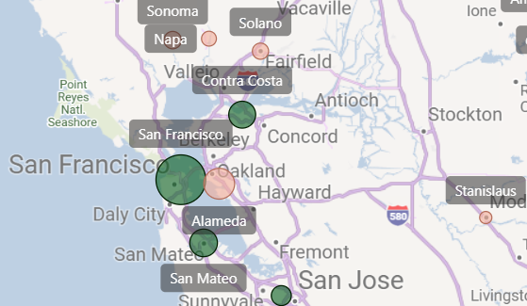
Bubble Size =
Population using Transit
Income Category:
High Income
Middle Income
Low Income

Slide 18
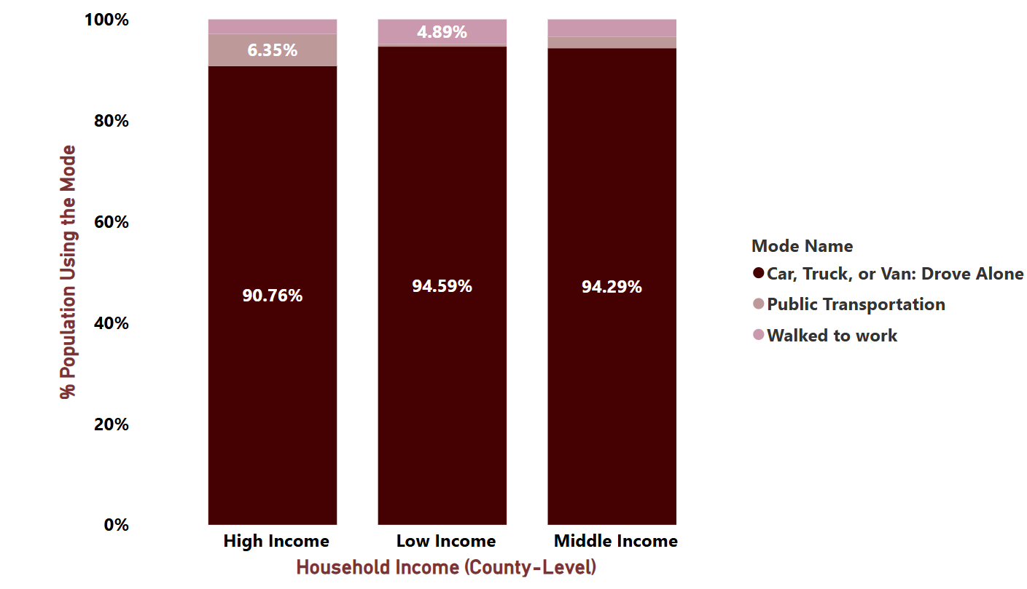
Income Doesn’t Predict Transit Use: Driving Alone Still Leads

Slide 19
OVERTIME SHIFTS
Which commuting modes have declined overtime?
How have commuting patterns shifted for Public Transportation?

Slide 20
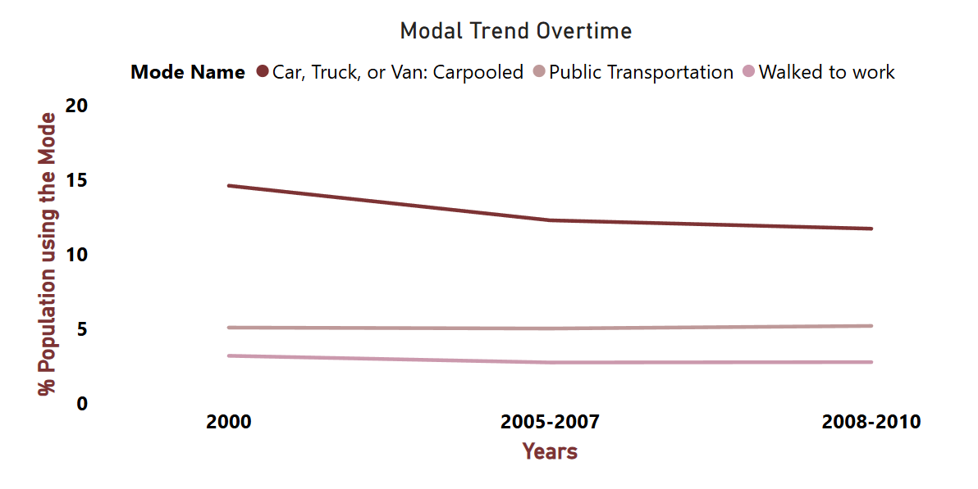
Carpooling & Walking Declined, Transit Saw No Growth

Slide 21




WHAT THE DATA REVEALS
Car Dominance
Low Transit Usage
Declining Commute Modes
Driving alone is the most preferred commute mode across regions and income groups, regardless of population size or income level.
Contrary to expectations, lower-income and minority groups do not necessarily rely on public transit. Its usage remains low and stagnant overall.
Shared and active commute modes like carpooling and walking have declined over time, with no meaningful growth in public transit usage during the same period.

Slide 22

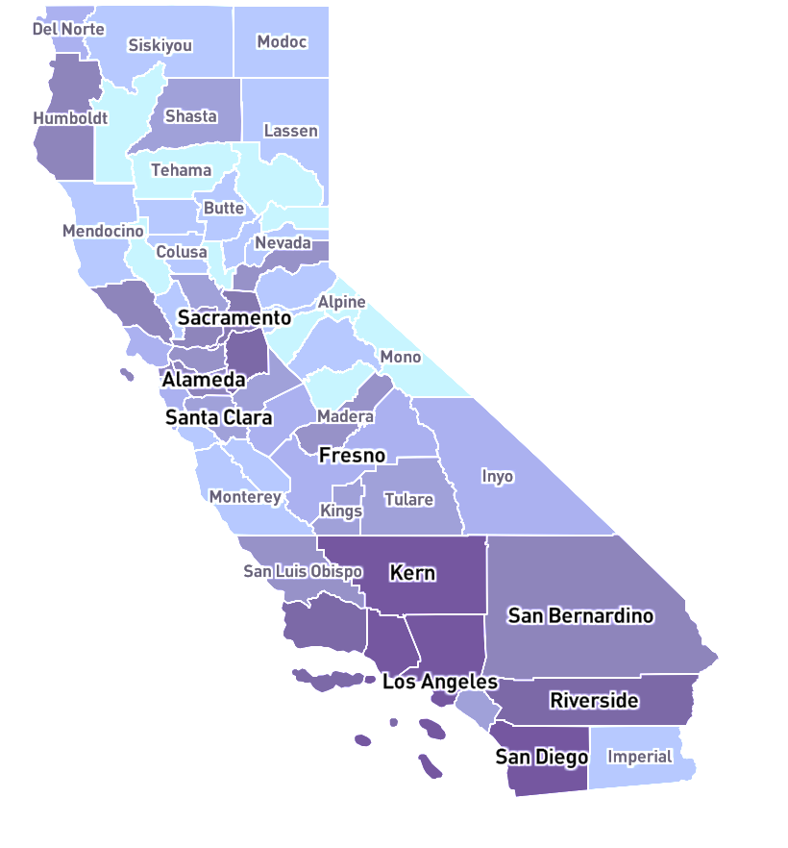
Where Are We Now?
Latest Trends in California
Post-pandemic Shift to Remote Work
Car Dependency |
Steady Decline in Transit Use
Low Public Transit Coverage

Slide 23


Where Are We Now?
Latest Trends in Bahrain
Car Usage Dominant | Persistent Traffic Congestion
Upgraded Road Infrastructure | Metro Expansion Underway
Low Public Transit Coverage

Slide 24





Online Voices on Bahrain’s Public Transport
Sample Size:
60 – 80 Comments

Slide 25
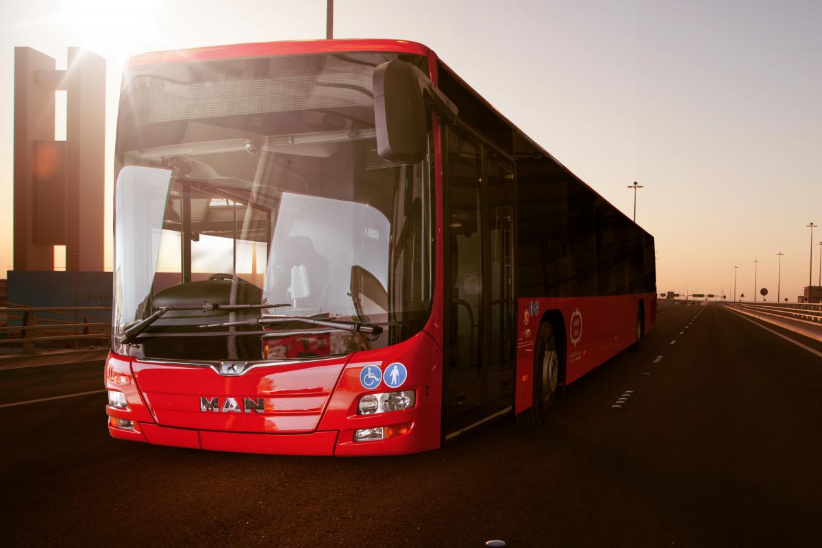
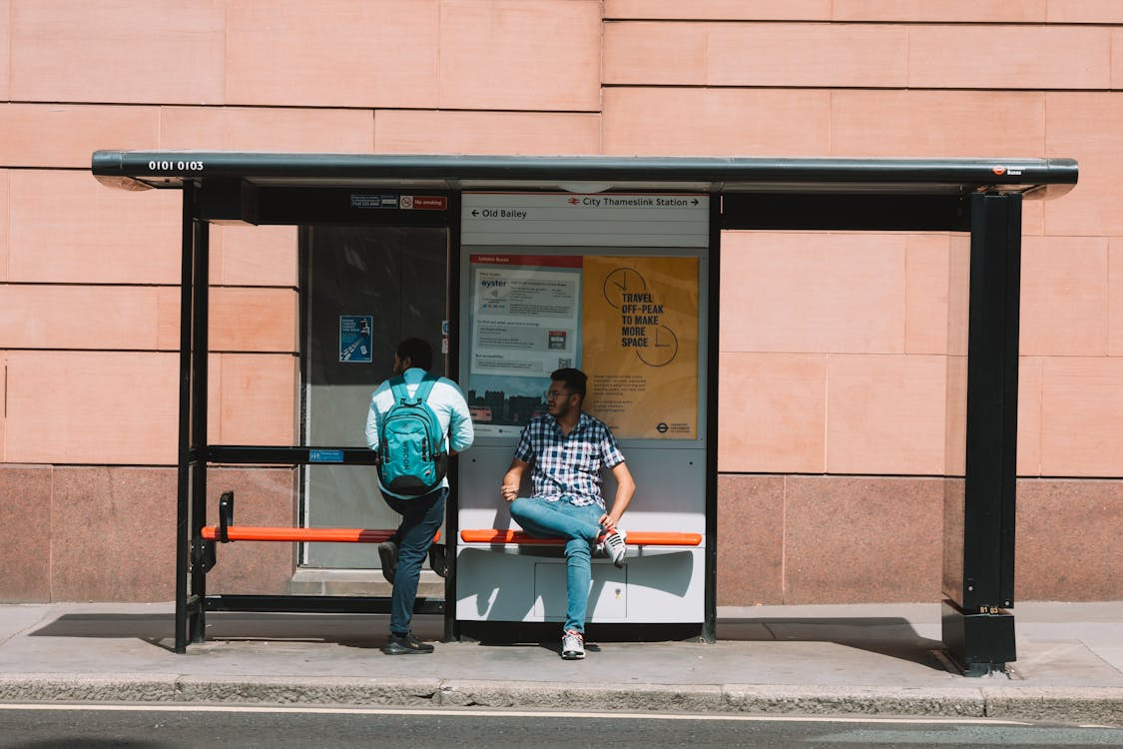


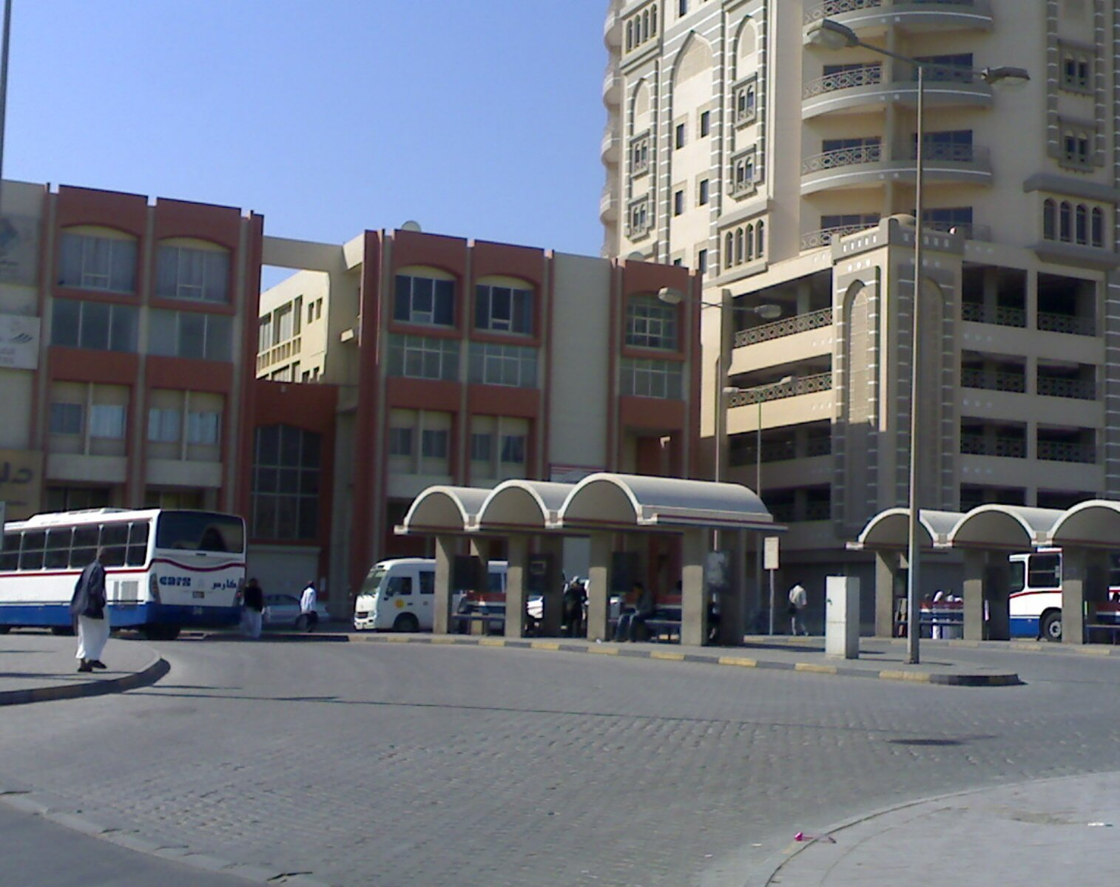
Online Voices on Bahrain’s Public Transport
Unreliable Timeliness
Delayed & Slow
Car-centric
Culture
Hot
Weather
Poor
Upkeep

Slide 26

Collect Local Data to Inform Policy
01
Gather national commuting data and incorporate richer external factors (e.g., regional aspects, occupation, income levels) for Bahrain-specific insights
02
Boost Transit Design & Access
Recommendations
Assess the needs of different population groups (e.g., students, low-income workers) to ensure transit is accessible for diverse groups
Takeaways for
Bahrain’s Transport Future
03
Enhance Walking Infrastructure
Improve walking conditions around residential and commercial areas with safe & shaded Infrastructure
04
Promote Transit Confidence & Culture
Launch awareness efforts that reshape public perception, increase trust in public transit, and reduce car dependence, directly aligning with Bahrain’s transportation goals

Slide 27
References
California Commuting Mode choice. Kaggle.
https://www.kaggle.com/datasets/thedevastator/california-commuting-mode-choice-from-2000-2010
Commute mode. (n.d.). Bureau of Transportation Statistics.
https://www.bts.gov/browse-statistical-products-and-data/state-transportation-statistics/commute-mode
Center for Jobs. California commuters continue to choose single occupant vehicles - Center for jobs.
https://centerforjobs.org/ca/special-reports/california-commuters-continue-to-choose-single-occupant-vehicles
‘Over 26,000 new cars hit Bahrain roads every year’ | THE DAILY TRIBUNE | KINGDOM OF BAHRAIN). DT News.
https://www.newsofbahrain.com/bahrain/85168.html
National Development: Bahrain Vision 2030 | Invest in Bahrain. Invest in Bahrain. https://www.bahrainedb.com/about-us/national-development-strategy
Staff, U. I. (2025, June 28). What’s Driving California? The Past, Present, and Future(s) of Transportation in the Golden State. UCLA Institute of Transportation Studies. https://www.its.ucla.edu/publication/whats-driving-california/
Provider map. (n.d.). California Mobility Marketplace.
https://www.camobilitymarketplace.org/provider-map.html

Slide 28

Thank you

